Slide 1
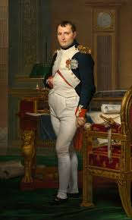
Napoleon Bonaparte
Napoleon Bonaparte was born 1769 to father Carlo Buonaparte and mother Letizia Romolino. At age 8 Napoleon was sent to France to study the Royal Military, Napoleon spent 8 years studying the Royal Military, if you count the year he spent at Ecole Militaire in Paris. From school he graduated Second Lieutenant of the Artillery at age 16. Years later he was sent to war at Toulon where he helped greatly in the victory over British forces, and soon after was made Brigadier General. Once the Directory came to power Napoleon had gained control of the French army in Italy and soon after defeated the Austrians in 1797. Napoleon Marched into Egypt but when he heard the Directory was losing power he abandoned his army and retreated to Paris to become 1 of the 3 councils in the new French government. THIS is how Napoleon gained power in France, from here he will go on to conquer over half of Europe and make a name for himself as one of the best military strategists of all time.
http://www.history.com/topics/napoleon

Slide 2
MACBETH
VS
NAPOLEON

Slide 3
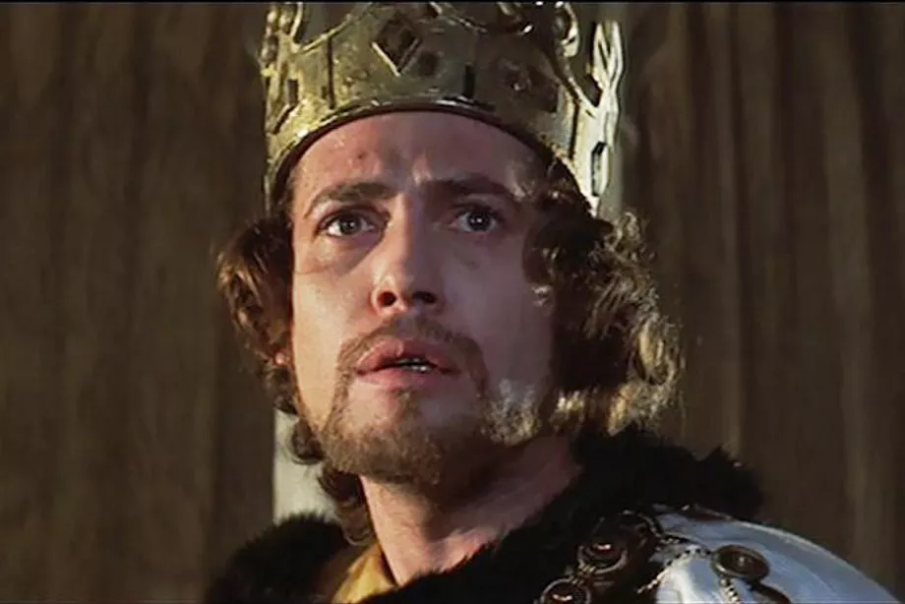
Macbeth and Napoleon Bonaparte have a lot in common. They both rose in ranks quickly, they both had blind ambition which rose them to power, but at same time this blinding ambition made them both underestimate their enemy and settings a great deal .

Slide 4
“I have done the deed. Didst thou not hear a noise?” (II,II,15)
This is the quote Macbeth gives after he has had “done the deed” of killing Duncan. He shows very little remorse
Napoleon marched into Egypt with an entire army on a campaign to conquer but when he heard that the French government was losing power he abandoned his army to fight blind so he could become 1 of the 3 councils in the new government

Slide 5
“Thou hast it now: king, Cawdor, Glamis, all,/As the weird women promised, and i fear/Thou played’st most foully for’t” (III,I,1)
This is the what Banquo says about Macbeth rising the ranks to king, fulfilling the prophecy, and drawing suspicion
Napoleon rose ranks quickly, but at the cost of his own men. Napoleon became powerful in France by becoming one of the three councils in the new government, he abandoned his army to do this.

Slide 6
“Let fall thy blade on vulnerable crests;/I bear a charmed life, which must not yield/To one of women born” (V,VII,40)
This is what Macbeth says while fighting Macduff, this shows he is very arrogant and undermines his enemy because Macduff happened to be C-sectioned
Napoleon was also very ignorant and thought he was so powerful that he couldn’t be conquered. It was this thinking that ultimately lead to his defeat.

Slide 7
Connection to Human Rights
Articles 3, 12
Article 3: Everyone has the right to life, liberty and security of person.
As Napoleon attacked the many different countries, his men would raid nearby houses to find any other guards that they had been fighting at the time. Although they did not kill innocent people, they still had broken into their houses and invaded their privacy.
Article 12: No one shall be subjected to arbitrary interference with his privacy, family, home or correspondence, nor to attacks upon his honour and reputation. Everyone has the right to the protection of the law against such interference or attacks.
Napoleon marched into many countries with with his army and had attacked them. For example, he attacked Egypt to wipe out british trade routes with India

Slide 8
Discussion Questions
Do you think Napoleon was a great ruler of his time or no. Why?
Who do think was a worse tyrant, Napoleon or Macbeth? Explain.

